Slide 1
HKN CS 61A Midterm 2 Review
Angela, Alex, Danny

Slide 2
Hello!
Hosted by HKN (hkn.eecs.berkeley.edu)
Office Hours:
Time: 11AM to 5PM
Location: 290 Cory, 345 Soda
Check our website: (hkn.eecs.berkeley.edu/tutor)
for exam archive, course guide, course surveys, tutoring schedule
[Disclaimer: This is an unofficial review session and HKN is not affiliated with this course. All of the topics we are reviewing will reflect the material you have covered, our experiences in CS61A, and past midterms. We make no promise that what we cover will necessarily reflect the content of the midterm.]
This is licensed under the Creative Commons CC BY-SA: feel free to share and edit, as long as you credit us and keep the license. For more information, visit https://creativecommons.org/licenses/by-sa/4.0/deed.en_US

Slide 3
Agenda
Lists, Tuples, Dictionaries, Sequences
Recursion
Data Abstraction
Nonlocal
Object-Oriented Programming
Inheritance
Linked Lists
Trees
Orders of Growth

Slide 4
Iterables
Lists: Sequences that are mutable. We can add, remove, and change the items of a list.
Tuples: Sequences that are immutable. We cannot change the items in a tuple; we can only create new tuples.
Dictionaries: Objects that map keys to values. Remember that the keys are unordered and unique!
Ranges: Objects that represent an interval of elements between two values.
Notes:
List Methods...
list.append(x)
Add an item to the end of the list; equivalent to a[len(a):] = [x].
list.extend(L)
Extend the list by appending all the items in the given list; equivalent to a[len(a):] = L.
list.insert(i, x)
Insert an item at a given position. The first argument is the index of the element before which to insert, so a.insert(0, x) inserts at the front of the list, and a.insert(len(a), x) is equivalent to a.append(x).
list.remove(x)
Remove the first item from the list whose value is x. It is an error if there is no such item.
list.pop([i])
Remove the item at the given position in the list, and return it. If no index is specified, a.pop() removes and returns the last item in the list. (The square brackets around the i in the method signature denote that the parameter is optional, not that you should type square brackets at that position. You will see this notation frequently in the Python Library Reference.)
list.index(x)
Return the index in the list of the first item whose value is x. It is an error if there is no such item.
list.count(x)
Return the number of times x appears in the list.
list.sort(cmp=None, key=None, reverse=False)
Sort the items of the list in place (the arguments can be used for sort customization, see sorted() for their explanation).
list.reverse()
Reverse the elements of the list, in place.

Slide 5
Iterables
List Methods...
list.append(x) Add an item to the end of the list; equivalent to a[len(a):] = [x].
list.extend(L) Extend the list by appending all the items in the given list; equivalent to a[len(a):] = L.
list.insert(i, x) Insert an item at a given position. The first argument is the index of the element before which to insert, so a.insert(0, x) inserts at the front of the list, and a.insert(len(a), x) is equivalent to a.append(x).
list.index(x) Return the index in the list of the first item whose value is x. It is an error if there is no such item.
list.count(x) Return the number of times x appears in the list.
list.remove(x) Remove the first item from the list whose value is x. It is an error if there is no such item.
list.pop([i]) Remove the item at the given position in the list, and return it. If no index is specified, a.pop() removes and returns the last item in the list. (The square brackets around the i in the method signature denote that the parameter is optional, not that you should type square brackets at that position. You will see this notation frequently in the Python Library Reference.)
list.sort(cmp=None, key=None, reverse=False) Sort the items of the list in place (the arguments can be used for sort customization, see sorted() for their explanation).
list.reverse()
Reverse the elements of the list, in place.
Notes:
List
x += [2] mutates
x = x + [2] will create a new list

Slide 6
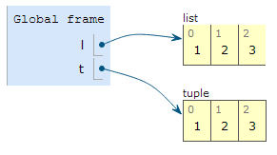
Box & Pointer Diagrams
>>> l = [1, 2, 3]
>>> t = (1, 2, 3)
What's the difference?
Notes:
Lis is immutable and tuples aren’t

Slide 7
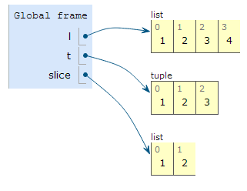

Box & Pointer Diagrams
append() mutates the original list.
>>> l = [1, 2, 3]
>>> t = (1, 2, 3)
>>> slice = l[:2]
>>> l.append(4)
Slicing creates a new list / tuple!

Slide 8
Draw the Box & Pointer Diagram!
r = ([1, 2, 1, 2],)
s = list(r)
t = r
r[0][2] = t[0]
s[0] = r[0][1:]
s[0][1][2][3] = 4
Notes:
In one element tuple creation, format requires a comma after the element.

Slide 9
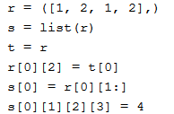
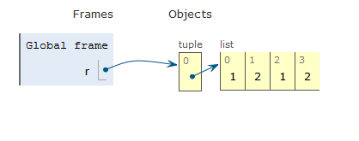
Draw the Box & Pointer Diagram!
Notes:
s makes a shallow copy of r, the tuple

Slide 10
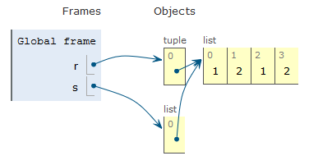
Draw the Box & Pointer Diagram!
Notes:
s makes a shallow copy of r, the tuple

Slide 11
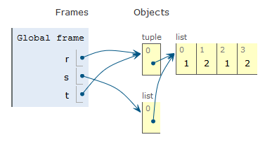
Draw the Box & Pointer Diagram!
Notes:
0th index of r is a pointer to a list and 2nd index of the list will point to the 0th index of t which is the pointer to a list

Slide 12
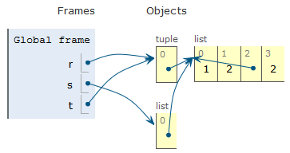
Draw the Box & Pointer Diagram!

Slide 13
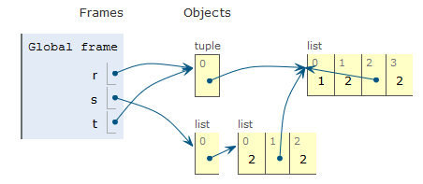
Draw the Box & Pointer Diagram!
Notes:
Austin, s[0] = r[0][1:] makes a shallow copy,right?

Slide 14
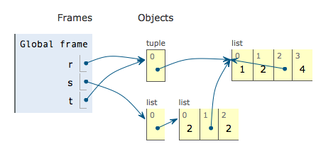
Draw the Box & Pointer Diagram!

Slide 15
Lists : Scope
lst = [1, 2, 3, 4, 5]
def add_five(to_be_changed):
for item in to_be_changed:
item += 5
>> add_five(lst)
>> lst
What would be the result?
Notes:
for item in to_be_changed makes a copy in its frame which gets destroyed

Slide 16
Lists : Scope
lst = [1, 2, 3, 4, 5]
def add_five(to_be_changed):
for item in to_be_changed:
item += 5
>> add_five(lst)
>> lst
What would be the result?
[1, 2, 3, 4, 5] because only the local variable item is modified, not the actual elements themselves in lst

Slide 17
Lists : Scope
lst = [1, 2, 3, 4, 5]
def add_five(to_be_changed):
for i in range(0, len(to_be_changed)):
to_be_changed[i] += 5
>> add_five(lst)
>> lst
What would be the result?
[6, 7, 8, 9, 10] yay!
Notes:
visits actual elements

Slide 18
List Comprehensions Example
>>> words = "We love CS61A!".split()
>>> words
['We', 'love', 'CS61A!']
>>> [len(w) for w in words]
______
>>> [w[i:] for w in words for i in [1, 2]]
______

Slide 19
List Comprehensions Example
>>> words = "We love CS61A!".split()
>>> words
['We', 'love', 'CS61A!']
>>> [len(w) for w in words]
[2, 4, 6]
>>> [w[i:] for w in words for i in [1, 2]]
______

Slide 20
List Comprehensions Example
>>> words = "We love CS61A!".split()
>>> words
['We', 'love', 'CS61A!']
>>> [len(w) for w in words]
[2, 4, 6]
>>> [w[i:] for w in words for i in [1, 2]]
['e', '', 'ove', 've', 's61A!', '61A!']

Slide 21
Dictionary Comprehensions
We can use list comprehension to construct dictionaries.
>>> d = {k : v for k, v in [(x, y) for x in range(3) for y in range(4)]}
Remember that dictionary keys are unique!
>>> d
_____

Slide 22
Dictionary Comprehensions
We can use list comprehension to construct dictionaries.
>>> d = {k : v for k, v in [(x, y) for x in range(3) for y in range(4)]}
Remember that dictionary keys are unique!
>>> d
{0: 3, 1: 3, 2: 3}

Slide 23
Dictionary Comprehensions
We can use list comprehension to construct dictionaries.
>>> d = {k : v for k, v in [(x, y) for x in range(3) for y in range(4)]}
For reference, the list is:
[(0, 0), (0, 1), (0, 2), (0, 3), (1, 0), (1, 1), (1, 2), (1, 3), (2, 0), (2, 1), (2, 2), (2, 3)]
We only care about the last instance of the key (bolded). Why?
What would we do if we wanted to have all the values above in the dictionary?

Slide 24
Dictionary Comprehensions
We can use list comprehension to construct dictionaries.
>>> d = {k : v for k, v in [(x, y) for x in range(3) for y in range(4)]}
For reference, the list is:
[(0, 0), (0, 1), (0, 2), (0, 3), (1, 0), (1, 1), (1, 2), (1, 3), (2, 0), (2, 1), (2, 2), (2, 3)]
We only care about the last instance of the key (bolded). Why?
Because dictionary keys are unique.
What would we do if we wanted to have all the values above in the dictionary? The value for each key would be a list.

Slide 25
Sequences
apply_to_all - Takes in a function and a sequence, and applies the function to each element of the sequence.
Input - Function that takes in one argument and any iterable sequence (list, tuple, etc.).
Output - Sequence of the same length as the input.
Example:
>>> apply_to_all(lambda x: x*x, [2, 3, 4])
[4, 9, 16]

Slide 26
Sequences
reduce - Takes in a function, a sequence and an optional initial value, and returns a single combined value. The result is accumulated as you iterate through the list.
Input - Function that takes in two arguments: an iterable sequence (list, tuple, etc.) and an (optional) starting value.
Output - Single element that is determined by combining the elements of the sequence using the input function.
Example:
>>> reduce(lambda so_far, curr: so_far+curr, [2, 3, 4]))
9

Slide 27
Sequences
Given a list, such as [1, 2, 3, 4, 5, 6], we want to reduce the list to a single number that is the 'flattened' version of the list. For example, the output for this particular list would be the number 123456.
>>> from functools import reduce
>>> t = [1, 2, 3, 4, 5, 6]
>>> reduce(______________________________, _____)
123456

Slide 28
Sequences
Given a list, such as [1, 2, 3, 4, 5, 6], we want to reduce the list to a single number that is the 'flattened' version of the list. For example, the output for this particular list would be the number 123456.
>>> from functools import reduce
>>> t = [1, 2, 3, 4, 5, 6]
>>> reduce(lambda so_far, curr: so_far*10 + curr, t)
123456
How?

Slide 29
Sequences
>>> t = [1, 2, 3, 4, 5, 6]
>>> reduce(lambda so_far, curr: so_far*10 + curr, t)
123456
First iteration:
so_far = 1
curr = 2

Slide 30
Sequences
>>> t = [1, 2, 3, 4, 5, 6]
>>> reduce(lambda so_far, curr: so_far*10 + curr, t)
123456
First iteration:
so_far = 1
curr = 2
result = 1*10 + 2 = 12

Slide 31
Sequences
>>> t = [1, 2, 3, 4, 5, 6]
>>> reduce(lambda so_far, curr: so_far*10 + curr, t)
123456
Next iteration:
so_far = 12
curr = 3
result = 12*10 + 3 = 123
and so on to get 123456.

Slide 32
Sequences
>>> cool = 'denero'
>>> story = [cool[i:2*i] for i in range(6)]
>>> story
_____
>>> bro = apply_to_all(len, story)
>>> bro
_____

Slide 33
Sequences
>>> cool = 'denero'
>>> story = [cool[i:2*i] for i in range(6)]
>>> story
['', 'e', 'ne', 'ero', 'ro', 'o']
>>> bro = apply_to_all(len, story)
>>> bro
_____

Slide 34
Sequences
>>> cool = 'denero'
>>> story = [cool[i:2*i] for i in range(6)]
>>> story
['', 'e', 'ne', 'ero', 'ro', 'o']
>>> bro = apply_to_all(len, story)
>>> bro
[0, 1, 2, 3, 2, 1]

Slide 35
Sequences
keep_if - Takes in a function and a sequence, and returns a new sequence that contains only the items for which the function returns True.
Input - Function that takes in one argument which returns True or False, and any iterable sequence (list, tuple, etc.).
Output - Sequence that contains the elements that satisfy the function.
For example:
>>> keep_if(lambda x: x % 2 == 0, [2, 3, 4])
[2, 4]

Slide 36
Sequences
>>> primes = [2, 3, 5, 7, 11]
>>> fib = [0, 1, 1, 2, 3]
>>> is_prime = lambda x: x in primes
>>> apply_to_all(is_prime, keep_if(is_prime, fib))
_____
>>> get_fib = lambda x: fib[x]
>>> apply_to_all(get_fib, keep_if(is_prime, fib))
_____

Slide 37
Sequences
>>> primes = [2, 3, 5, 7, 11]
>>> fib = [0, 1, 1, 2, 3]
>>> is_prime = lambda x: x in primes
>>> apply_to_all(is_prime, keep_if(is_prime, fib)) [2, 3]
_____
>>> get_fib = lambda x: fib[x]
>>> apply_to_all(get_fib, keep_if(is_prime, fib))
_____

Slide 38
Sequences
>>> primes = [2, 3, 5, 7, 11]
>>> fib = [0, 1, 1, 2, 3]
>>> is_prime = lambda x: x in primes
>>> apply_to_all(is_prime, keep_if(is_prime, fib))) [2, 3]
[True, True]
>>> get_fib = lambda x: fib[x]
>>> apply_to_all(get_fib, keep_if(is_prime, fib))
_____

Slide 39
Sequences
>>> primes = [2, 3, 5, 7, 11]
>>> fib = [0, 1, 1, 2, 3]
>>> is_prime = lambda x: x in primes
>>> apply_to_all(is_prime, keep_if(is_prime, fib))) [2, 3]
[True, True]
>>> get_fib = lambda x: fib[x]
>>> apply_to_all(get_fib, keep_if(is_prime, fib)) [2, 3]
_____

Slide 40
Sequences
>>> primes = [2, 3, 5, 7, 11]
>>> fib = [0, 1, 1, 2, 3]
>>> is_prime = lambda x: x in primes
>>> apply_to_all(is_prime, keep_if(is_prime, fib))) [2, 3]
[True, True]
>>> get_fib = lambda x: fib[x]
>>> apply_to_all(get_fib, keep_if(is_prime, fib)) [2, 3]
# intermediate step [get_fib(2), get_fib(3)]

Slide 41
Sequences
>>> primes = [2, 3, 5, 7, 11]
>>> fib = [0, 1, 1, 2, 3]
>>> is_prime = lambda x: x in primes
>>> apply_to_all(is_prime, keep_if(is_prime, fib))) [2, 3]
[True, True]
>>> get_fib = lambda x: fib[x]
>>> apply_to_all(get_fib, keep_if(is_prime, fib)) [2, 3]
# intermediate step [fib[2], fib[3]]

Slide 42
Sequences
>>> primes = [2, 3, 5, 7, 11]
>>> fib = [0, 1, 1, 2, 3]
>>> is_prime = lambda x: x in primes
>>> apply_to_all(is_prime, keep_if(is_prime, fib))) [2, 3]
[True, True]
>>> get_fib = lambda x: fib[x]
>>> apply_to_all(get_fib, keep_if(is_prime, fib)) [2, 3]
# intermediate step [fib[2], fib[3]]
[1, 2]

Slide 43

Recursion

Slide 44
What is recursion?
Defining a function in terms of itself (a function that calls on itself)
Mutual Recursion = defining a set of functions in terms of themselves
As a reminder, here are some simple recursive examples:
# Fibonacci sequence
def fib(n):
if n < 2:
return n
return fib(n-1) + fib(n-2)
# Factorial
def factorial(n):
if n == 0:
return 1
return n * factorial(n-1)

Slide 45
How To?
Given an instance of the problem, how would you break it into smaller problems?
What are your base cases?

Slide 46
The Recursive Leap of Faith
Have a clear idea of what your function is supposed to do and what it returns
If-else: If - base case(s), Else - solve the same problem, but smaller
What function can I call that solves the same problem?
This one!
The leap of faith: trust that your function will do what you want it to do

Slide 47
Fancy Factorial
def helper(x, y):
if x == 0:
return y
return helper(x - 1, x * y)
def factorial(x):
return helper(x, 1)
print(factorial(5))
link

Slide 48
Create your own recursion
Create a function div(x, y) that performs floor division
Create a function gcd(x, y) that computes GCD

Slide 49
Create your own recursion
Create a function div(x, y) that performs floor division
def div(x, y):
if x < y:
return 0
return 1 + div(x - y, y)
Create a function gcd(x, y) that computes GCD
def gcd(x, y):
if x > y:
return gcd(y, x)
if x == 0:
return y
return gcd(x, y - x)

Slide 50
Create your own recursion
REMINDER: For a number expressed in base 2, each digit is a 1 or 0 representing a power of 2
EX:
21 = 1(16) + 0(8) + 1(4) + 0(2) + 1(1)
In base 2,
21 = 10101
Create a function that converts a positive integer to base 2
def to_base_2(n):
if ______:
return _
if ______:
return _
return _____ + _____

Slide 51
Create your own recursion
Create a function that converts a positive integer to base 2
def to_base_2(n):
if n == 1:
return 1
if n == 0:
return 0
return 10 * to_base_2(n//2) + to_base_2(n%2)

Slide 52
Recursion with Decision Making
How many ways are there to go up a flight of n stairs if you can only take 1 or 2 steps at a time?
def stairs(n):
if n <= 0:
return 0
else if n == 1:
return 1
else if n == 2:
return 2
else:
return stairs(n - 1) + stairs(n - 2)

Slide 53

Data Abstraction
http://xkcd.com/676/

Slide 54
Data Abstraction
How data is internally represented
How data is used
Abstraction Barrier

Slide 55
Data Abstraction Example: Points
def make_point(x, y):
return (x, y)
def x(point):
return point[0]
def y(point):
return point[1]
def dist(point1, point2):
return sqrt((x(point2) - x(point1)) ** 2 +
(y(point2) - y(point1)) ** 2)
Constructor - Builds an object of the abstract data type.
Selector - Extracts relevant information from the object.
Notes:
I changed the x() and y() functions to be x_val() and y_val() to be more clear about what they do

Slide 56
Write these functions to complete the segment data abstraction!
make_segment(start, end)
Constructs a line segment between points at start and end.
start(segment), end(segment)
Returns the start and end points respectively.
length(segment)
Returns the distance between the segment’s start and end points.
consecutive(seg1, seg2)
Returns True if seg1's end is the same as seg2's start, or False otherwise.
For reference, the data abstraction for points has the following constructors and selectors:
make_point(x, y)
x(point)
y(point)
dist(point1, point2)
Notes:
“Represent lines as two-tuples of the start and end points

Slide 57
Write these functions to complete the segment data abstraction! (sol’n)
def make_segment(start, end):
return (start, end)

Slide 58
Write these functions to complete the segment data abstraction! (sol’n)
def make_segment(start, end):
return (start, end)
def start(segment):
return segment[0]
def end(segment):
return segment[1]

Slide 59
Write these functions to complete the segment data abstraction! (sol’n)
def make_segment(start, end):
return (start, end)
def start(segment):
return segment[0]
def end(segment):
return segment[1]
def length(segment):
return dist(start(segment), end(segment))

Slide 60
Write these functions to complete the segment data abstraction! (sol’n)
def make_segment(start, end):
return (start, end)
def start(segment):
return segment[0]
def end(segment):
return segment[1]
def length(segment):
return dist(start(segment), end(segment))
def consecutive(seg1, seg2):
return end(seg1) == start(seg2)

Slide 61
Write these functions to complete the segment data abstraction! (sol’n)
def make_segment(start, end):
return (start, end)
def start(segment):
return segment[0]
def end(segment):
return segment[1]
def length(segment):
return dist(start(segment), end(segment))
def consecutive(seg1, seg2):
return end(seg1) == start(seg2)
return ((x(end(seg1)) == x(start(seg2))) and
(y(end(seg1)) == y(start(seg2))))

Slide 62
Fix this!
Your friend has written a function to compute the total length of a path of line segments, but has broken some abstraction barriers in doing so. Rewrite this function so that it uses the line segment abstraction properly.
# Assume path is a tuple of line segments.
def path_length(path):
prev = path[0][0]
ret = dist(prev, path[0][1])
for (s, cur) in path[1:]:
if s != prev:
return None
else:
ret += dist(s, cur)
prev = cur
return ret
Notes:
Start, end, length, consecutive

Slide 63
Fix this! (sol’n)
Your friend has written a function to compute the total length of a path of line segments, but has broken some abstraction barriers in doing so. Rewrite this function so that it uses the line segment abstraction properly.
# Assume path is a tuple of line segments.
def path_length(path):
prev = path[0][0]
ret = dist(prev, path[0][1]) length(prev)
for (s, cur) in path[1:]: for cur in path[1:]:
if s != prev: if not consecutive(prev, cur):
return None
else:
ret += dist(s, cur) length(cur)
prev = cur
return ret

Slide 64
Nonlocal

Slide 65
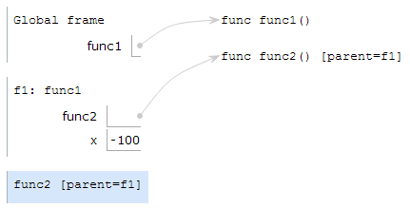
Nonlocal in Environment Diagrams
def func1():
x = -100
def func2():
nonlocal x
x = 3
func2()
func1()
If a variable is nonlocal, you must follow parents and look between (but not including) current frame and global.
3

Slide 66
Nonlocal in Environment Diagrams
def func1():
def func2():
x = 4
def func3():
def func4():
nonlocal x
x = 3
func4()
func3()
func2()
func1()
Does This Work?
Yes!

Slide 67
Nonlocal in Environment Diagrams
def func1():
def func2(x):
nonlocal x
x = 3
func2(4)
func1()
Does This Work?
No.
x is a local variable (in the same frame)

Slide 68
Nonlocal in Environment Diagrams
x = 50
def func1():
def func2():
nonlocal x
x = 3
func2()
func1()
Does This Work?
No.
x is in the global frame.

Slide 69
Draw the Environment Diagram
Challenge Problem
def k(b):
def seven(up):
b.extend(['<3','<3'])
nonlocal b
b = 5
up[0][0] = 'cs61a'
return up[0:2]
return seven((b, 3, 6))
k(['cookies'])

Slide 70
Environment Diagram Notes
Don't need nonlocal to mutate something!
def k(b):
def seven(up):
b.extend(['<3','<3'])
nonlocal b
b = 5
up[0][0] = 'cs61a'
return up[0:2]
return seven((b, 3, 6))
k(['cookies'])
Need nonlocal to change what value a variable points to
Slicing creates a new list with the same values.

Slide 71
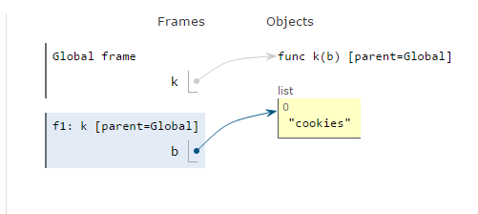
Draw the Environment Diagram
def k(b):
def seven(up):
b.extend(['<3','<3'])
nonlocal b
b = 5
up[0][0] = 'cs61a'
return up[0:2]
return seven((b, 3, 6))
k(['cookies'])

Slide 72
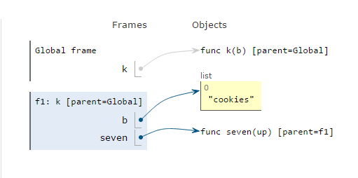
Draw the Environment Diagram
def k(b):
def seven(up):
b.extend(['<3','<3'])
nonlocal b
b = 5
up[0][0] = 'cs61a'
return up[0:2]
return seven((b, 3, 6))
k(['cookies'])

Slide 73
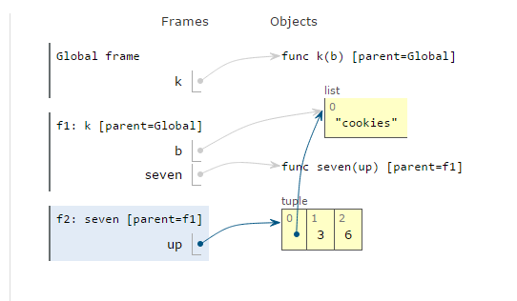
Draw the Environment Diagram
def k(b):
def seven(up):
b.extend(['<3','<3'])
nonlocal b
b = 5
up[0][0] = 'cs61a'
return up[0:2]
return seven((b, 3, 6))
k(['cookies'])

Slide 74
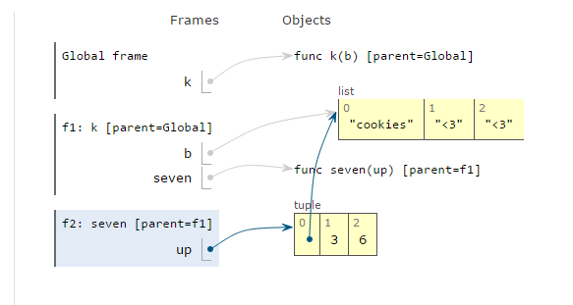
Draw the Environment Diagram
def k(b):
def seven(up):
b.extend(['<3','<3'])
nonlocal b
b = 5
up[0][0] = 'cs61a'
return up[0:2]
return seven((b, 3, 6))
k(['cookies'])

Slide 75
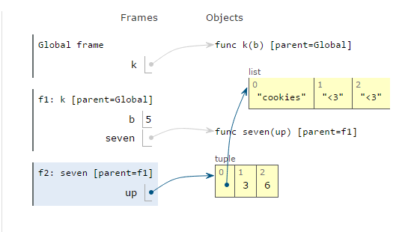
Draw the Environment Diagram
def k(b):
def seven(up):
b.extend(['<3','<3'])
nonlocal b
b = 5
up[0][0] = 'cs61a'
return up[0:2]
return seven((b, 3, 6))
k(['cookies'])

Slide 76
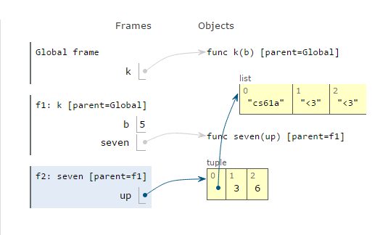
Draw the Environment Diagram
def k(b):
def seven(up):
b.extend(['<3','<3'])
nonlocal b
b = 5
up[0][0] = 'cs61a'
return up[0:2]
return seven((b, 3, 6))
k(['cookies'])

Slide 77
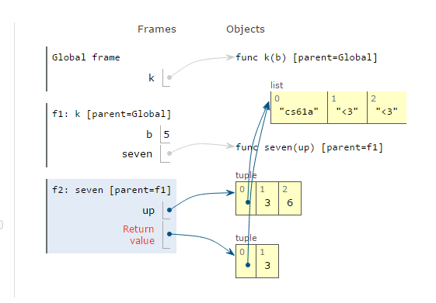
Draw the Environment Diagram
def k(b):
def seven(up):
b.extend(['<3','<3'])
nonlocal b
b = 5
up[0][0] = 'cs61a'
return up[0:2]
return seven((b, 3, 6))
k(['cookies'])

Slide 78
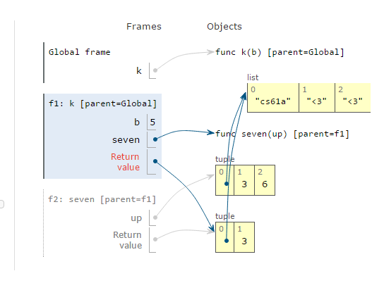
Draw the Environment Diagram
def k(b):
def seven(up):
b.extend(['<3','<3'])
nonlocal b
b = 5
up[0][0] = 'cs61a'
return up[0:2]
return seven((b, 3, 6))
k(['cookies'])

Slide 79
Nonlocal: Domo Population
Paul really likes Domos, so he buys n to start with. They multiply at the rate given by a function at every timestep. However, if the function does not increase the number of domos, use the most recent function that did. The starter function is lambda x: x * 2. When the number is greater than or equal to the capacity of his home, he gives 9/10 away to his beloved students. (It requires 1 timestep to give away 9/10 of the domos.)
def domo_population(n, capacity):
"""
>>> timestep = domo_population(5, 40)
>>> timestep(lambda x: x - 10)
10
>>> timestep(lambda x: x * 4)
40
>>> timestep(lambda x: x * 3)
4
"""

Slide 80
Nonlocal: Domo Population (Soln.)
def domo_population(n, capacity):
increase = lambda x: x * 2
def timestep(fn):
nonlocal increase, n
if fn(n) > n: # determine whether or not fn increases n
increase = fn
if n < capacity:
n = increase(n)
else:
n = n // 10 # don't increase if too many
return n
return timestep

Slide 81
Break
hkn.mu/feedback

Slide 82
Object-Oriented Programming

Slide 83
OOP: Person
>>> p = Person('John Denero', 8341)
# This calls __init__.
>>> p.greet()
"Hi, I'm John Denero"
>>> p.has_birthday()
8342
>>> Person.has_birthday()
has_birthday() missing 1 required argument: 'self'
>>> Person.has_birthday(p)
8343
>>> Person.num_people
1
>>> p.num_people
1
class Person(object):
num_people = 0
def __init__(self, name, age):
self.name = name
self.age = age
Person.num_people += 1
def has_birthday(self):
self.age = self.age + 1
return self.age
def greet(self):
return "Hi, I'm " + self.name

Slide 84
How Property Lookup Works
What does Python do when it sees “p.has_birthday”?
Checks if “has_birthday” is a property of the instance p
If not found in p, checks if it is a property of the class Person
If it finds “has_birthday” here and it is a function, it binds the first parameter (self) to p. The resulting function takes one less parameter and is called a “bound method”
If not found, raise AttributeError

Slide 85
How Property Lookup Works
What does Python do when it sees “Person.has_birthday”?
Checks if “has_birthday” is a property of the class Person
Even if it is a function, the first parameter is not bound to anything!
If not found, raise AttributeError

Slide 86
OOP: Person, revisited #1
>>> p = Person('John Denero', 8341)
# This calls __init__.
>>> p.greet()
"Hi, I'm John Denero"
>>> p.has_birthday()
8342
>>> Person.has_birthday()
has_birthday() missing 1 required argument: 'self'
>>> Person.has_birthday(p)
8343
p.has_birthday() and Person.has_birthday(p) do the same thing!
class Person(object):
num_people = 0
def __init__(self, name, age):
self.name = name
self.age = age
Person.num_people += 1
def has_birthday(self):
self.age = self.age + 1
return self.age
def greet(self):
return "Hi, I'm " + self.name

Slide 87
OOP: Person, revisited #2
>>> p = Person('John Denero', 8341)
# This calls __init__.
>>> p.has_birthday = Person.has_birthday
>>> p.has_birthday()
missing one required argument: ‘self’
Now, p’s “has_birthday” now points to the Person class’s “has_birthday” method. So the first parameter “self” is not bound after lookup
class Person(object):
num_people = 0
def __init__(self, name, age):
self.name = name
self.age = age
Person.num_people += 1
def has_birthday(self):
self.age = self.age + 1
return self.age
def greet(self):
return "Hi, I'm " + self.name

Slide 88
OOP: Person, revisited #3
>>> p = Person('John Denero', 8341)
# This calls __init__.
>>> Person.has_birthday = lambda: 3
>>> p.has_birthday()
<lambda>() takes 0 positional arguments but 1 was given
“p” is implicitly passed as the first argument, since it is bound as the first parameter.
But the function doesn’t take any arguments, so we get an error.
class Person(object):
num_people = 0
def __init__(self, name, age):
self.name = name
self.age = age
Person.num_people += 1
def has_birthday(self):
self.age = self.age + 1
return self.age
def greet(self):
return "Hi, I'm " + self.name

Slide 89
OOP: Person, revisited #4 (Tricky)
>>> p = Person('John Denero', 8341)
# This calls __init__.
>>> Person.has_birthday = p.has_birthday
>>> q = Person('Paul Hilfinger', 9000)
>>> q.has_birthday()
8342
Python keeps track of whether a function represents a “bound method” and won’t try to bind additional parameters
class Person(object):
num_people = 0
def __init__(self, name, age):
self.name = name
self.age = age
Person.num_people += 1
def has_birthday(self):
self.age = self.age + 1
return self.age
def greet(self):
return "Hi, I'm " + self.name

Slide 90
OOP: Plant
>>> p = Plant(10)
>>> p # repr example
Plant<10, 0>
>>> Plant.energy_for_leaf
10
>>> p.energy_for_leaf
_____
>>> p.if_sunny
_____
>>> p.photosynthesize
_____
>>> p.photo_fn
_____
>>> p.photosynthesize()
_____
>>> p
_____
>>> p.leaves
_____
>>> p
_____
sunny = True
class Plant:
energy_for_leaf = 10
def __init__(self, leaves, if_sunny=1.5, not_sunny=0.5):
self._leaves, self.energy = leaves, 0
self.photo_fn = lambda leaves, sunny: leaves * (if_sunny if sunny else not_sunny)
def photosynthesize(self):
self.energy += self.photo_fn(self.leaves, sunny)
@property
def leaves(self):
self.grow_leaves()
return self._leaves
def grow_leaves(self):
while self.energy > self.energy_for_leaf:
self._leaves += 1
self.energy -= self.energy_for_leaf
def __repr__(self):
return 'Plant<{}, {}>'.format(self._leaves, self.energy)

Slide 91
OOP: Plant
>>> p = Plant(10)
>>> p # repr example
Plant<10, 0>
>>> Plant.energy_for_leaf
10
>>> p.energy_for_leaf
10
>>> p.if_sunny
_____
>>> p.photosynthesize
_____
>>> p.photo_fn
_____
>>> p.photosynthesize()
_____
>>> p
_____
>>> p.leaves
_____
>>> p
_____
sunny = True
class Plant:
energy_for_leaf = 10
def __init__(self, leaves, if_sunny=1.5, not_sunny=0.5):
self._leaves, self.energy = leaves, 0
self.photo_fn = lambda leaves, sunny: leaves * (if_sunny if sunny else not_sunny)
def photosynthesize(self):
self.energy += self.photo_fn(self.leaves, sunny)
@property
def leaves(self):
self.grow_leaves()
return self._leaves
def grow_leaves(self):
while self.energy > self.energy_for_leaf:
self._leaves += 1
self.energy -= self.energy_for_leaf
def __repr__(self):
return 'Plant<{}, {}>'.format(self._leaves, self.energy)

Slide 92
OOP: Plant
sunny = True
class Plant:
energy_for_leaf = 10
def __init__(self, leaves, if_sunny=1.5, not_sunny=0.5):
self._leaves, self.energy = leaves, 0
self.photo_fn = lambda leaves, sunny: leaves * (if_sunny if sunny else not_sunny)
def photosynthesize(self):
self.energy += self.photo_fn(self.leaves, sunny)
@property
def leaves(self):
self.grow_leaves()
return self._leaves
def grow_leaves(self):
while self.energy > self.energy_for_leaf:
self._leaves += 1
self.energy -= self.energy_for_leaf
def __repr__(self):
return 'Plant<{}, {}>'.format(self._leaves, self.energy)
>>> p = Plant(10)
>>> p # repr example
Plant<10, 0>
>>> Plant.energy_for_leaf
10
>>> p.energy_for_leaf
10
>>> p.if_sunny
AttributeError
>>> p.photosynthesize
_____
>>> p.photo_fn
_____
>>> p.photosynthesize()
_____
>>> p
_____
>>> p.leaves
_____
>>> p
_____

Slide 93
OOP: Plant
>>> p = Plant(10)
>>> p # repr example
Plant<10, 0>
>>> Plant.energy_for_leaf
10
>>> p.energy_for_leaf
10
>>> p.if_sunny
AttributeError
>>> p.photosynthesize
<bound method at ...>
>>> p.photo_fn
_____
>>> p.photosynthesize()
_____
>>> p
_____
>>> p.leaves
_____
>>> p
_____
sunny = True
class Plant:
energy_for_leaf = 10
def __init__(self, leaves, if_sunny=1.5, not_sunny=0.5):
self._leaves, self.energy = leaves, 0
self.photo_fn = lambda leaves, sunny: leaves * (if_sunny if sunny else not_sunny)
def photosynthesize(self):
self.energy += self.photo_fn(self.leaves, sunny)
@property
def leaves(self):
self.grow_leaves()
return self._leaves
def grow_leaves(self):
while self.energy > self.energy_for_leaf:
self._leaves += 1
self.energy -= self.energy_for_leaf
def __repr__(self):
return 'Plant<{}, {}>'.format(self._leaves, self.energy)

Slide 94
OOP: Plant
>>> p = Plant(10)
>>> p # repr example
Plant<10, 0>
>>> Plant.energy_for_leaf
10
>>> p.energy_for_leaf
10
>>> p.if_sunny
AttributeError
>>> p.photosynthesize
<bound method at ...>
>>> p.photo_fn
<function at ...>
>>> p.photosynthesize()
_____
>>> p
_____
>>> p.leaves
_____
>>> p
_____
sunny = True
class Plant:
energy_for_leaf = 10
def __init__(self, leaves, if_sunny=1.5, not_sunny=0.5):
self._leaves, self.energy = leaves, 0
self.photo_fn = lambda leaves, sunny: leaves * (if_sunny if sunny else not_sunny)
def photosynthesize(self):
self.energy += self.photo_fn(self.leaves, sunny)
@property
def leaves(self):
self.grow_leaves()
return self._leaves
def grow_leaves(self):
while self.energy > self.energy_for_leaf:
self._leaves += 1
self.energy -= self.energy_for_leaf
def __repr__(self):
return 'Plant<{}, {}>'.format(self._leaves, self.energy)

Slide 95
OOP: Plant
sunny = True
class Plant:
energy_for_leaf = 10
def __init__(self, leaves, if_sunny=1.5, not_sunny=0.5):
self._leaves, self.energy = leaves, 0
self.photo_fn = lambda leaves, sunny: leaves * (if_sunny if sunny else not_sunny)
def photosynthesize(self):
self.energy += self.photo_fn(self.leaves, sunny)
@property
def leaves(self):
self.grow_leaves()
return self._leaves
def grow_leaves(self):
while self.energy > self.energy_for_leaf:
self._leaves += 1
self.energy -= self.energy_for_leaf
def __repr__(self):
return 'Plant<{}, {}>'.format(self._leaves, self.energy)
>>> p = Plant(10)
>>> p # repr example
Plant<10, 0>
>>> Plant.energy_for_leaf
10
>>> p.energy_for_leaf
10
>>> p.if_sunny
AttributeError
>>> p.photosynthesize
<bound method at ...>
>>> p.photo_fn
<function at ...>
>>> p.photosynthesize()
>>> p
_____
>>> p.leaves
_____
>>> p
_____

Slide 96
OOP: Plant
sunny = True
class Plant:
energy_for_leaf = 10
def __init__(self, leaves, if_sunny=1.5, not_sunny=0.5):
self._leaves, self.energy = leaves, 0
self.photo_fn = lambda leaves, sunny: leaves * (if_sunny if sunny else not_sunny)
def photosynthesize(self):
self.energy += self.photo_fn(self.leaves, sunny)
@property
def leaves(self):
self.grow_leaves()
return self._leaves
def grow_leaves(self):
while self.energy > self.energy_for_leaf:
self._leaves += 1
self.energy -= self.energy_for_leaf
def __repr__(self):
return 'Plant<{}, {}>'.format(self._leaves, self.energy)
>>> p = Plant(10)
>>> p # repr example
Plant<10, 0>
>>> Plant.energy_for_leaf
10
>>> p.energy_for_leaf
10
>>> p.if_sunny
AttributeError
>>> p.photosynthesize
<bound method at ...>
>>> p.photo_fn
<function at ...>
>>> p.photosynthesize()
>>> p
Plant<10, 15.0>
>>> p.leaves
_____
>>> p
_____

Slide 97
OOP: Plant
sunny = True
class Plant:
energy_for_leaf = 10
def __init__(self, leaves, if_sunny=1.5, not_sunny=0.5):
self._leaves, self.energy = leaves, 0
self.photo_fn = lambda leaves, sunny: leaves * (if_sunny if sunny else not_sunny)
def photosynthesize(self):
self.energy += self.photo_fn(self.leaves, sunny)
@property
def leaves(self):
self.grow_leaves()
return self._leaves
def grow_leaves(self):
while self.energy > self.energy_for_leaf:
self._leaves += 1
self.energy -= self.energy_for_leaf
def __repr__(self):
return 'Plant<{}, {}>'.format(self._leaves, self.energy)
>>> p = Plant(10)
>>> p # repr example
Plant<10, 0>
>>> Plant.energy_for_leaf
10
>>> p.energy_for_leaf
10
>>> p.if_sunny
AttributeError
>>> p.photosynthesize
<bound method at ...>
>>> p.photo_fn
<function at ...>
>>> p.photosynthesize()
>>> p
Plant<10, 15.0>
>>> p.leaves
11
>>> p
_____

Slide 98
OOP: Plant
sunny = True
class Plant:
energy_for_leaf = 10
def __init__(self, leaves, if_sunny=1.5, not_sunny=0.5):
self._leaves, self.energy = leaves, 0
self.photo_fn = lambda leaves, sunny: leaves * (if_sunny if sunny else not_sunny)
def photosynthesize(self):
self.energy += self.photo_fn(self.leaves, sunny)
@property
def leaves(self):
self.grow_leaves()
return self._leaves
def grow_leaves(self):
while self.energy > self.energy_for_leaf:
self._leaves += 1
self.energy -= self.energy_for_leaf
def __repr__(self):
return 'Plant<{}, {}>'.format(self._leaves, self.energy)
>>> p = Plant(10)
>>> p # repr example
Plant<10, 0>
>>> Plant.energy_for_leaf
10
>>> p.energy_for_leaf
10
>>> p.if_sunny
AttributeError
>>> p.photosynthesize
<bound method at ...>
>>> p.photo_fn
<function at ...>
>>> p.photosynthesize()
>>> p
Plant<10, 15.0>
>>> p.leaves
11
>>> p
Plant<11, 5.0>

Slide 99
Inheritance

Slide 100
Inheritance: Example
class Person(object):
def __init__(self, name, age):
self.name = name
self.age = age
def has_birthday(self):
self.age = self.age + 1
return self.age
def greet(self):
return "Hi, I'm " + self.name
class Fireman(object):
def __init__(self, name, age, fid):
self.name = name
self.age = age
self.fid = fid
def has_birthday(self):
self.age = self.age + 1
return self.age
def greet(self):
return "Hi, I'm " + self.name
def put_out_fire(self):
print(‘PUTTING OUT FIRE!’)

Slide 101
Inheritance: Example
class Person(object):
def __init__(self, name, age):
self.name = name
self.age = age
def has_birthday(self):
self.age = self.age + 1
return self.age
def greet(self):
return "Hi, I'm " + self.name
class Fireman(object):
def __init__(self, name, age, fid):
self.name = name
self.age = age
self.fid = fid
def has_birthday(self):
self.age = self.age + 1
return self.age
def greet(self):
return "Hi, I'm " + self.name
def put_out_fire(self):
print(‘PUTTING OUT FIRE!’)
How can we use the concept of inheritance to improve our Fireman class?

Slide 102
Inheritance: Better Example
class Fireman(Person):
def __init__(self, name, age, fid):
Person.__init__(self, name, age)
self.fid = fid
def put_out_fire(self):
print(‘PUTTING OUT FIRE!’)
class Person(object):
def __init__(self, name, age):
self.name = name
self.age = age
def has_birthday(self):
self.age = self.age + 1
return self.age
def greet(self):
return "Hi, I'm " + self.name
>>> f = Fireman('John DeNero', 8341, 1)
>>> f.name
'John DeNero'
>>> f.has_birthday()
8342
>>> f.put_out_fire()
PUTTING OUT FIRE!

Slide 103
Jedi
class Jedi(object):
def __init__(self, name, lightsaber_color, ls_power):
self.name = name
self.ls_color = lightsaber_color
self.ls_power = ls_power
def lightsaber_duel(self, other_jedi):
if self.ls_power > other_jedi.ls_power:
print(self.name + ‘ defeated ’ + other_jedi.name)
elif self.ls_power == other_jedi.ls_power:
print(‘Tie!’)
else:
print(self.name + ‘ has fallen to ’ + other_jedi.name)

Slide 104
DarkJedi
class Jedi(object):
def __init__(self, name, lightsaber_color, ls_power):
self.name = name
self.ls_color = lightsaber_color
self.ls_power = ls_power
def lightsaber_duel(self, other_jedi):
…
class DarkJedi(Jedi):
def __init__(self, name, lightsaber_color, ls_power, evil_power):
"*** YOUR CODE HERE ***"
def use_power(self):
print(self.evil_power)
def lightsaber_duel(self, other_jedi):
"*** YOUR CODE HERE ***"

Slide 105
DarkJedi
class Jedi(object):
def __init__(self, name, lightsaber_color, ls_power):
self.name = name
self.ls_color = lightsaber_color
self.ls_power = ls_power
def lightsaber_duel(self, other_jedi):
…
class DarkJedi(Jedi):
def __init__(self, name, lightsaber_color, ls_power, evil_power):
Jedi.__init__(self, name, lightsaber_color, ls_power)
self.evil_power = evil_power
def use_power(self):
print(self.evil_power)
def lightsaber_duel(self, other_jedi):
Jedi.lightsaber_duel(self, other_jedi)

Slide 106
DarkJedi
class DarkJedi(Jedi):
def __init__(self, name, lightsaber_color, ls_power, evil_power):
Jedi.__init__(self, name, lightsaber_color, ls_power)
self.evil_power = evil_power
def use_power(self):
print(self.evil_power)
def lightsaber_duel(self, other_jedi):
Jedi.lightsaber_duel(self, other_jedi)
Do we need this?

Slide 107
DarkJedi
class DarkJedi(Jedi):
def __init__(self, name, lightsaber_color, ls_power, evil_power):
Jedi.__init__(self, name, lightsaber_color, ls_power)
self.evil_power = evil_power
def use_power(self):
print(self.evil_power)
def lightsaber_duel(self, other_jedi):
Jedi.lightsaber_duel(self, other_jedi)
Do we need this?
Nope! It is inherited from Jedi.

Slide 108
Facepalm
It is 2001 and you are a college student at Cal. You decide to create Facepalm, an application for the Palm Pilot that maintains information about different people in your address book.
Facepalm will have a Profile for each person. You decide to write a class called Profile that simulates a Facepalm profile. It stores a person's name, the person's institution, and a list of Profiles of the person's friends. It also has the add_friend(profile) method, which adds the given profile to the list of friends’ Profiles, if profile is not already present.

Slide 109
Facepalm - Solution
class Profile(object):
def __init__(self, name, inst):
"*** YOUR CODE HERE ***"
def add_friend(self, profile):
"*** YOUR CODE HERE ***"

Slide 110
Facepalm - Solution
class Profile(object):
def __init__(self, name, inst):
self.name = name
self.inst = inst
self.friends = []
def add_friend(self, profile):
if profile not in self.friends:
self.friends.append(profile)

Slide 111
Facepalm … with profit
You aren’t exactly raking in the money that you were expecting from the app. To try to get some revenue, you decide that profiles will be restricted by default. A restricted profile can only add 100 friends, beyond which they are not able to add more friends. If a person tries to add more friends when they have 100 already, you should tell them to upgrade to PaidProfiles, which lift this restriction.
Modify Profile.add_friend to implement this restriction. Also define another class PaidProfile to mimic the Profile class, except in the behavior of the add_friend method.

Slide 112
Facepalm … with profit
class Profile(object):
def __init__(self, name, inst):
self.name = name
self.inst = inst
self.friends = []
def add_friend(self, profile):
"*** YOUR CODE HERE ***"
class PaidProfile(Profile):
"*** YOUR CODE HERE ***"

Slide 113
Facepalm … with profit - Solution
class Profile(object):
...
def add_friend(self, profile):
if profile not in self.friends:
if len(self.friends) < 100:
self.friends.append(profile)
else:
print(“You have 100 friends, please upgrade!”)
class PaidProfile(Profile):
def add_friend(self, profile): if profile not in self.friends:
self.friends.append(profile)

Slide 114

Next Topic: Linked Lists

Slide 115
Linked Lists
Wikipedia: a linked list is a linear collection of data elements, called nodes, each pointing to the next node by means of a pointer

Slide 116
Linked Lists
class Link: """A linked list with a first element and the rest.""" empty = () def __init__(self, first, rest=empty): assert rest is Link.empty or isinstance(rest, Link) self.first = first self.rest = rest def __getitem__(self, i): if i == 0: return self.first else: return self.rest[i-1] def __len__(self): return 1 + len(self.rest)

Slide 117

Linked Lists
class Link: """A linked list with a first element and the rest.""" empty = () def __init__(self, first, rest=empty): assert rest is Link.empty or isinstance(rest, Link) self.first = first self.rest = rest def __getitem__(self, i): if i == 0: return self.first else: return self.rest[i-1] def __len__(self): return 1 + len(self.rest)
Make an Linked List with a 2 in it?
Link(2)
A Linked List with 1 then 2 in it?
Link(1, Link(2))

Slide 118
Linked Lists
r = Link(1, Link(2, Link(3)))
How do we retrieve the 1?
r.first
Retrieve the 2?
r.rest.first

Slide 119
Linked Lists
Write reduce:
def reduce(lst, combiner, default):
"""
>>> r = Link(1, Link(2, empty))
>>> reduce(r, lambda x, y: x + y, 0)
3
"""

Slide 120
Linked Lists
Write reduce:
def reduce(lst, combiner, default):
if lst is Link.empty:
return default
return combiner(lst.first,
reduce(lst.rest, combiner, default))

Slide 121
Linked Lists
Define a procedure skip_consecutives that, given an Rlist of numbers, removes the consecutive duplicates with mutation.
def skip_consecutives(r):
"""
>>> r = Link(1, Link(1, Link(3,
Link(2, Link(1))))
>>> skip_consecutives(r)
# r is now Link(1, Link(3, Link(2, Link(1))))
"""

Slide 122
Linked Lists
Define a procedure skip_consecutives that, given a Linked List of numbers, removes the consecutive duplicates with mutation.
def skip_consecutives(r):
if r is Link.empty:
return
current = r.rest
while current is not Link.empty and r.first == current.first:
r.rest = r.rest.rest
current = r.rest
skip_consecutives(r.rest)

Slide 123
Linked Lists
Define a procedure map_linkify that, given a regular list and a function, returns a linked list version of the regular list with the function applied to all values.
def map_linkify(lst, f):
"""
>>> lst = [1, 2, 3]
>>> f = lambda x: x + 1
>>> r = map_linkify(lst, f)
>>> r
Link(2, Link(3, Link(4)))
"""

Slide 124
Linked Lists
def map_linkify(lst, f):
if not lst:
return Link.empty
else:
return Link(f(lst[0]),
map_linkify(lst[1:], f))

Slide 125
Linked Lists: Challenge Question
You have a linked list (the object-based version). What is the most efficient way to find the middle element (assume of the linked list has odd length)?

Slide 126
Break
:)
hkn.mu/feedback

Slide 127
Linked Lists: Challenge Question
You have a linked list (the object-based version). What is the most efficient way to find the middle element?
Answer: Keep two pointers. Iterate one pointer two nodes at a time, but iterate the other only one node at a time. When the first node hits the end of the list, the second hits the middle element. (This is a popular interview question!)

Slide 128

Next Topic: Trees

Slide 129
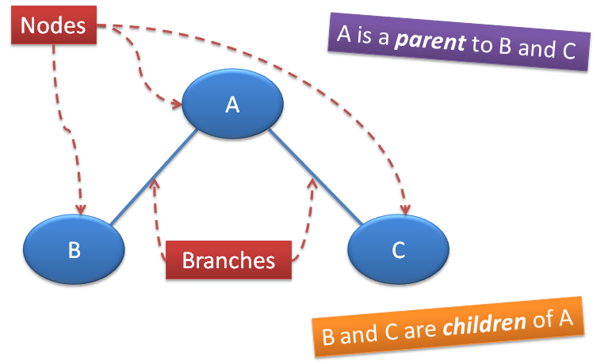
Trees: Review
Branches

Slide 130
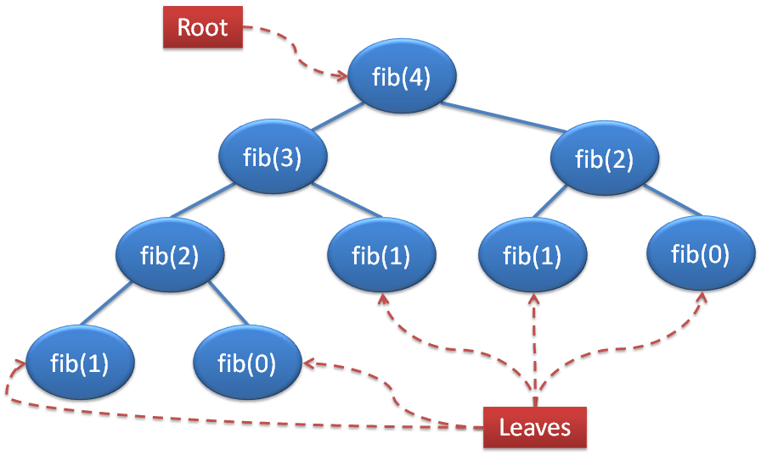
Trees: Review

Slide 131
Trees: Review
class Tree: def __init__(self, entry, branches=()): self.entry = entry for branch in branches: assert isinstance(branch, Tree) self.branches = branches
def __repr__(self): if self.branches: return 'Tree({0}, {1})'.format(self.entry, repr(self.branches)) else: return 'Tree({0})'.format(repr(self.entry))
def is_leaf(self): return not self.branches

Slide 132
Trees: Review (Binary Tree)
Binary Tree:
Not Binary Tree:

Slide 133
Trees: Review
class BTree(Tree):
empty = Tree(None)
empty.is_empty = True
def __init__(self, entry, left=empty, right=empty): for branch in (left, right):
assert isinstance(branch, BTree) or branch.is_empty
Tree.__init__(self, entry, (left, right))
self.is_empty = False
@property
def left(self):
return self.branches[0]
@property
def right(self):
return self.branches[1]

Slide 134
Trees: Review
Notice that trees are also recursively defined.
A tree is made from other trees –
these trees are its subtrees.
Thus, a general strategy to write functions that operate on tree problems is recursively:
Apply the function on the subtrees and
combine the results in a relevant way.

Slide 135
Tree Recursion
Trees have nodes and branches
Nodes hold values, branches are other trees
Recursion follows a common pattern: operate on the node and then iterate through all branches
Use recursion to go down a tree; use iteration to go across

Slide 136
Tree Recursion Example
Write a function that takes a tree where the node value is an integer and return the value of the smallest node
Write a function that takes a tree where the node value is an integer and sum up all the nodes.
def find_min(t):
def add_nodes(t):

Slide 137
Tree Recursion Example
Write a function that takes a tree where the node value is an integer and return the value of the smallest node
Write a function that takes a tree where the node value is an integer and sum up all the nodes.
def find_min(t):
branches = [t.root]
for b in t.branches:
branches += find_min(b)
return min(branches)
def add_nodes(t):
sum = t.root
for b in t.branches:
sum += add_nodes(b)
return sum

Slide 138
Trees
Write a function find_darcia that takes in a tree and returns whether it contains the string “Gan”:
>>> find_darcia(Tree(“Gan”, (Tree(“Pilfinger”)))
True
>>> find_darcia(Tree(“mank demes”))
False
def find_darcia(t):
***YOUR CODE HERE***

Slide 139
Trees
def find_darcia(t):
if t.entry == “Gan”:
return True
for b in t.branches:
if find_darcia(b):
return True
return False

Slide 140
Trees
Write the function prod_tree, which takes a Tree of numbers and returns the product of all the numbers in the Tree.
>>> t = Tree(1, Tree(2), Tree(3, Tree(4,
Tree(5),
Tree(6))))
>>> prod_tree(t)
720

Slide 141
Trees
Write the function prod_tree, which takes a Tree of numbers and returns the product of all the numbers in the Tree.
def prod_tree(t):
result = t.entry
for branch in t.branches:
result *= prod_tree(branch)
return result

Slide 142
Trees (Binary: HARD!)
Write a function all_paths that takes in a BTree and returns a list of tuples, where each nested tuple is a path from the root to a leaf.
>>> all_paths(t)
[(1, 2, 3), (1, 2, 4), (1, 5, 6), (1, 5, 7)]

Slide 143
Trees (Binary: HARD!)
1
2
5
3
4
6
7
>>> all_paths(t)
[(1, 2, 3), (1, 2, 4), (1, 5, 6), (1, 5, 7)]

Slide 144
Trees (Binary: HARD!)
def all_paths(t):
if t is BTree.empty:
return []
if t.branches == ():
return [(t.entry,)]
paths_in_left = all_paths(t.left)
paths_in_right = all_paths(t.right)
result = []
for path in paths_in_left + paths_in_right:
result.append((t.entry,) + path)
return result

Slide 145

Next Topic: Orders of Growth

Slide 146
Orders of Growth: Review
Way of expressing how long a function/program takes to execute in terms of the size of its input as it grows very large (given as a variable, usually n).
Big Ө Notation: Throw away constants in front of variable:
25n² ---> Ө(n²)
Throw away smaller terms:
n² + 1000n ---> Ө(n²)

Slide 147
Orders of Growth
Keep in mind what happens as n grows large.
What is the order of growth for this function?
def func(n):
for i in range(n // 2):
print(i)
return n

Slide 148
Orders of Growth
Keep in mind what happens as n grows large.
What is the order of growth for this function?
def func(n):
for i in range(n // 2):
print(i)
return n
Ө(n)

Slide 149
Orders of Growth
What is the order of growth for this function?
def denero(denero):
denero = 5 * denero
john = denero**2
while (john > 0): print (“Announcements!”)
john = john - 1

Slide 150
Orders of Growth
What is the order of growth for this function?
def denero(denero):
denero = 5 * denero
john = denero**2
while (john > 0): print (“Announcements!”)
john = john - 1
Ө(denero²)

Slide 151
Orders of Growth
What is the order of growth for this function?
def doge(n):
if n <= 1:
print (“Wow”)
return n
return doge(n - 1) + doge(n - 2)

Slide 152

Orders of Growth
What is the order of growth for this function?
def doge(n):
if n <= 1:
print (“Much wow”)
return n
return doge(n - 1) + doge(n - 2)
Ө(2^{n})

Slide 153
Orders of Growth
n
1
n-1
n-2
2
n-2
n-3
n-3
n-4
4
……
1
1
1
0
0
2^{n}
1 + 2 + 2² + ... + 2^{n} = 2^{n+1} - 1 = Ө(2^{n})

Slide 154
Orders of Growth

Slide 155
Orders of Growth
What is the order of growth for this function?
def doge(n):
if n <= 1:
print (“Much wow”)
return n
return doge(n - 1) + doge(n - 2)
Note: 2^{n+1} = 2^{n} · 2¹ = 2 · 2^{n}

Slide 156
Orders of Growth
What is the order of growth for this function?
def func(n):
if n <= 1:
return n
return 1 + func(n // 2)

Slide 157
Orders of Growth
What is the order of growth for this function?
def func(n):
if n <= 1:
return n
return 1 + func(n // 2)
Ө(log n)

Slide 158
Orders of Growth
What is the order of growth for this function?
def func(n):
if n <= 1:
return n
return 1 + func(n // 2)
Note: log(2n) = log 2 + log n = log n + 1

Slide 159
Orders of Growth
What is the order of growth for this function?
def func(n):
if n <= 1:
return 1
if n <= 50:
return func(n - 1) + func(n - 2)
elif n > 50:
return func(50) + func(49)

Slide 160
Orders of Growth
What is the order of growth for this function?
def func(n):
if n <= 1:
return 1
if n <= 50:
return func(n - 1) + func(n - 2)
elif n > 50:
return func(50) + func(49)
Ө(1)

Slide 161
Orders of Growth
What is the order of growth for this function?
def func(n):
lst = []
for i in range(n):
lst.append(i)
# Order of growth of ‘append’ is O(1) in the length of the list.
if n <= 1:
return 1
if n <= 50:
return func(n - 1) + func(n - 2)
elif n > 50:
return func(50) + func(49)

Slide 162
Orders of Growth
What is the order of growth for this function?
def func(n):
lst = []
for i in range(n):
lst.append(i)
# Order of growth of ‘append’ is O(1) in the length of the list.
if n <= 1:
return 1
if n <= 50:
return func(n - 1) + func(n - 2)
elif n > 50:
return func(50) + func(49)
Ө(n)

Slide 163
Orders of Growth
def foo(x, y):
if x == 0:
return 1
if y > 0:
return foo(x, y - 1)
return 1 + foo(x // 2, y)
What is the order of growth in time for foo(x, baz(y)) with respect to x?
What is the order of growth in time for foo(x, baz(y)) with respect to y?
def baz(z):
return abs(z)

Slide 164
Orders of Growth
def foo(x, y):
if x == 0:
return 1
if y > 0:
return foo(x, y - 1)
return 1 + foo(x // 2, y)
What is the order of growth in time for foo(x, baz(y)) with respect to x?
Ө(log x)
What is the order of growth in time for foo(x, baz(y)) with respect to y?
def baz(z):
return abs(z)

Slide 165
Orders of Growth
def foo(x, y):
if x == 0:
return 1
if y > 0:
return foo(x, y - 1)
return 1 + foo(x // 2, y)
What is the order of growth in time for foo(x, baz(y)) with respect to x?
Ө(log x)
What is the order of growth in time for foo(x, baz(y)) with respect to y?
Ө(y)
def baz(z):
return abs(z)

Slide 166
Orders of Growth
def foo(x, y):
if x == 0:
return 1
if y > 0:
return foo(x, y - 1)
return 1 + foo(x // 2, y)
What is the order of growth in time for foo(x, baz(y)) with respect to x?
Ө(log x)
What is the order of growth in time for foo(x, baz(y)) with respect to y?
Ө(y)
What is the order of growth in time for foo(x, baz(y)) with respect to x and y?
def baz(z):
return abs(z)

Slide 167
Orders of Growth
def foo(x, y):
if x == 0:
return 1
if y > 0:
return foo(x, y - 1)
return 1 + foo(x // 2, y)
What is the order of growth in time for foo(x, baz(y)) with respect to x?
Ө(log x)
What is the order of growth in time for foo(x, baz(y)) with respect to y?
Ө(y)
What is the order of growth in time for foo(x, baz(y)) with respect to x and y?
Ө(log(x) + y)
def baz(z):
return abs(z)

Slide 168
Feedback
We would like your feedback on this review session, so that we can improve for future review sessions. This is completely optional.
If you would like to provide suggestions, complaints or comments, please fill out hkn.mu/feedback .
Thanks for coming, and best of luck on your midterm!

Slide 169
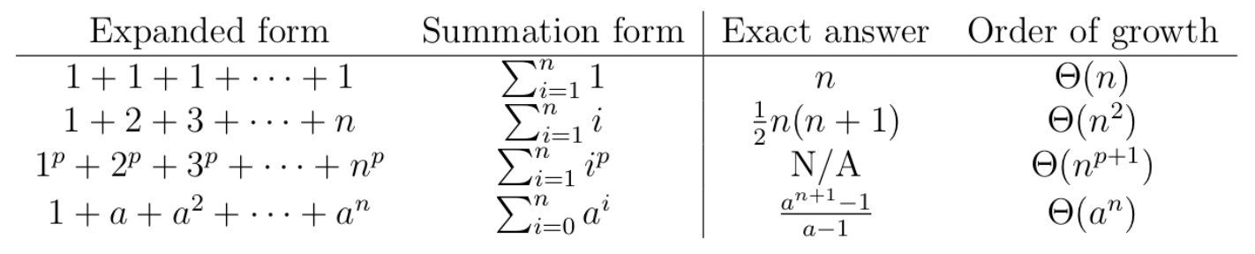
Orders of Growth
Some useful facts:
If a variable x is divided by a constant y at each step, it will reach 1 after about log_{y} x steps.

Slide 170
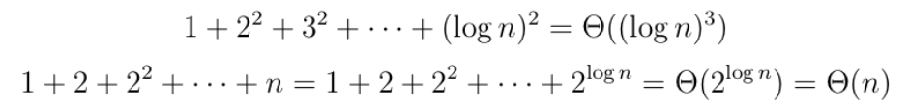
Orders of Growth
The above formulas can be used flexibly. For example:

